Slide 1



PHISHING AWARENESS TRAINING
Recognizing, Understanding & Preventing Phishing Attacks
CodeAlpha Cyber Security Internship
Task 02 – Phishing Awareness Training
Presented by: Your Name
Domain: Cyber Security

Slide 2
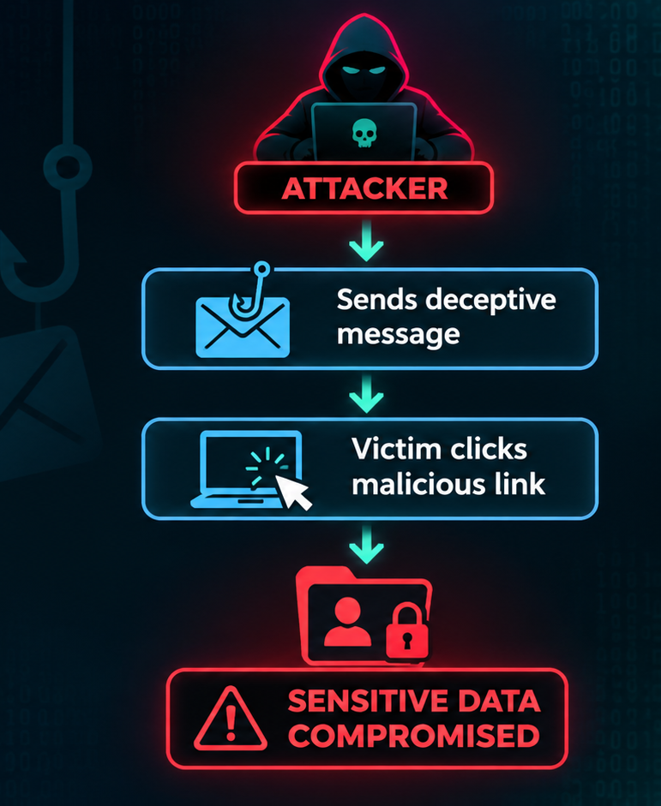
Cyber Security
What is phishing?
Phishing is a cyberattack in which attackers impersonate trusted individuals or organizations to trick victims into revealing sensitive information, clicking malicious links, or downloading harmful attachments.
A form of social engineering.
Exploits human trust and emotions.
Targets passwords, financial information and personal data.
Commonly delivered through emails, SMS and websites.

Slide 3
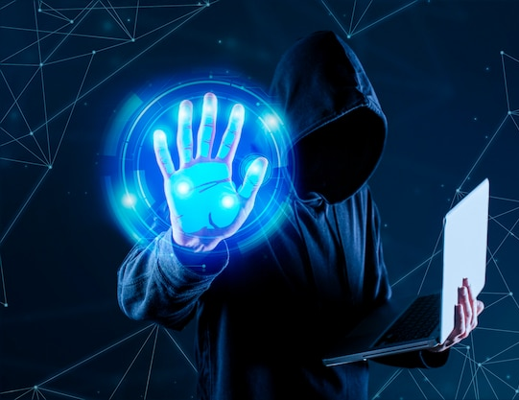
Cyber Security
How does a phishing attack work?
Preparation: Attacker creates a fake email or website.
Delivery: Victim receives the deceptive message.
Deception: Message creates urgency or trust.
Interaction: Victim clicks a link or shares information.
Exploitation: Attacker uses the obtained information.

Slide 4
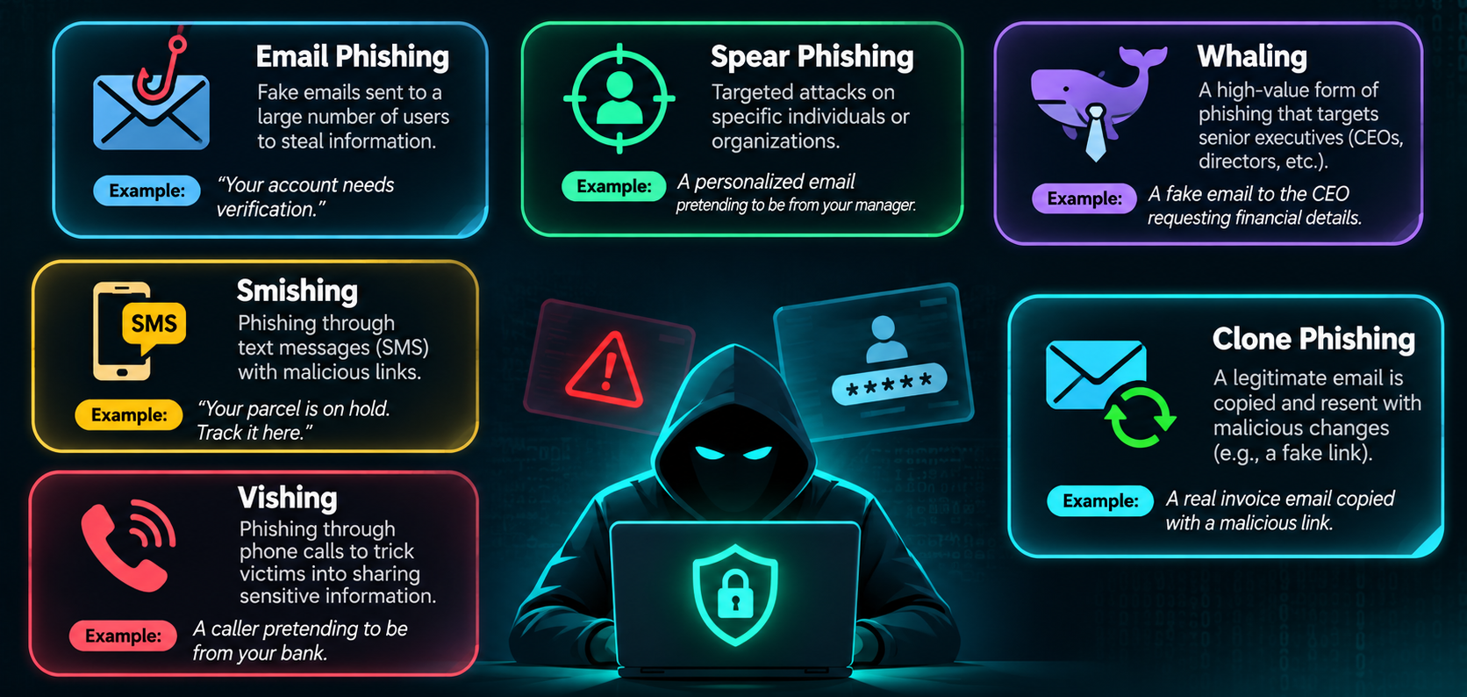
Cyber Security
Types and techniques

Slide 5
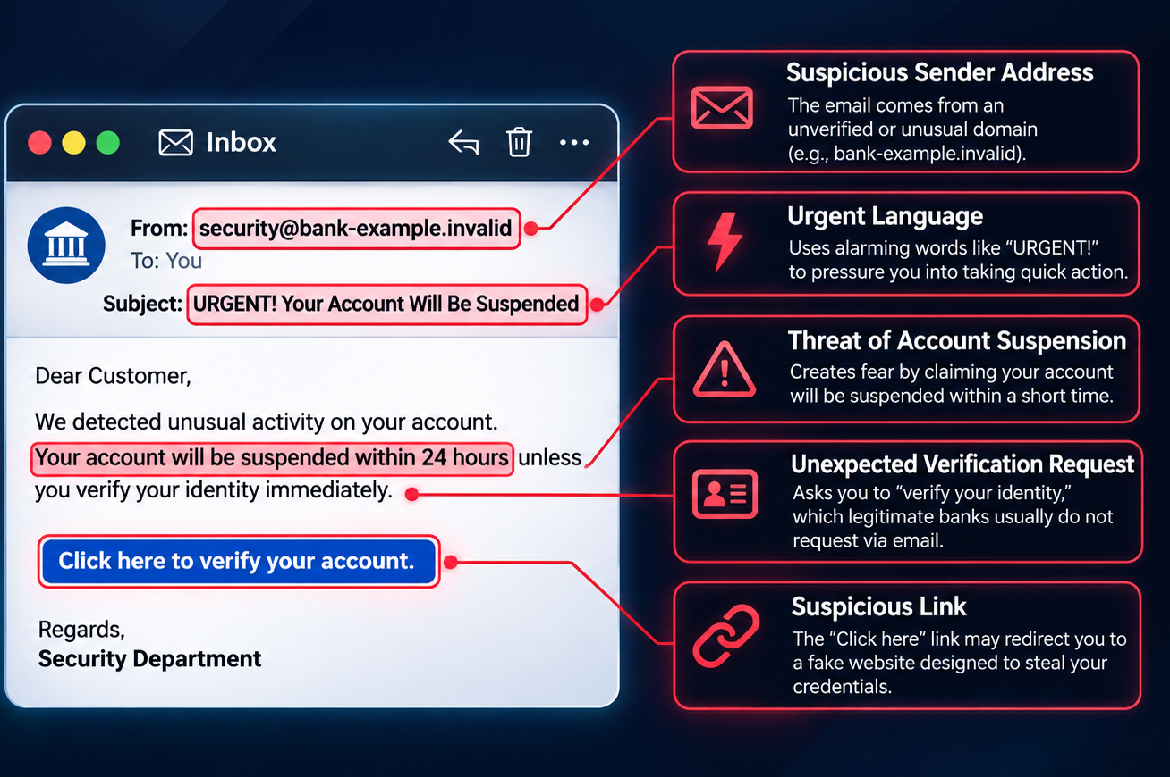
Cyber Security
Anatomy of a phishing email

Slide 6

Social engineering techniques
Definition: Social engineering manipulates human behavior to gain unauthorized access to information or systems.
Fear – Threatening account suspension.
Urgency – Giving extremely short deadlines.
Authority – Pretending to be a manager.
Greed – Offering fake rewards.
Curiosity – Using tempting links.
Trust – Impersonating familiar people.

Slide 7
Real-world phishing scenarios
Banking Account Suspension Scam
Fake Internship Offer
Victim receives: An internship offer requesting personal details or registration fees.
Suspicious: Unverified company, unrealistic offer, payment demand.
Action: Verify the company; never pay or share sensitive information.
Victim receives: An email threatening account suspension unless identity is verified.
Suspicious: Urgency, fake sender, verification link.
Action: Don't click; contact the bank officially.
Fake Delivery Scam
Victim receives: An SMS demanding a small delivery fee through a link.
Suspicious: Unknown sender, unexpected payment, suspicious link.
Action: Verify through the courier's official website.

Slide 8

Phishing vs legitimate communication
Indicator | Legitimate | Phishing
Sender | Verified identity | Suspicious identity
Language | Professional | Often urgent or threatening
Links | Expected domain | Misleading domain
Requests | Appropriate channels | Unexpected credentials requests
Attachments | Expected files | Unexpected files

Slide 9


01
Email security
02
Password security
How to protect yourself
03
Browsing security
04
Device security

Slide 10
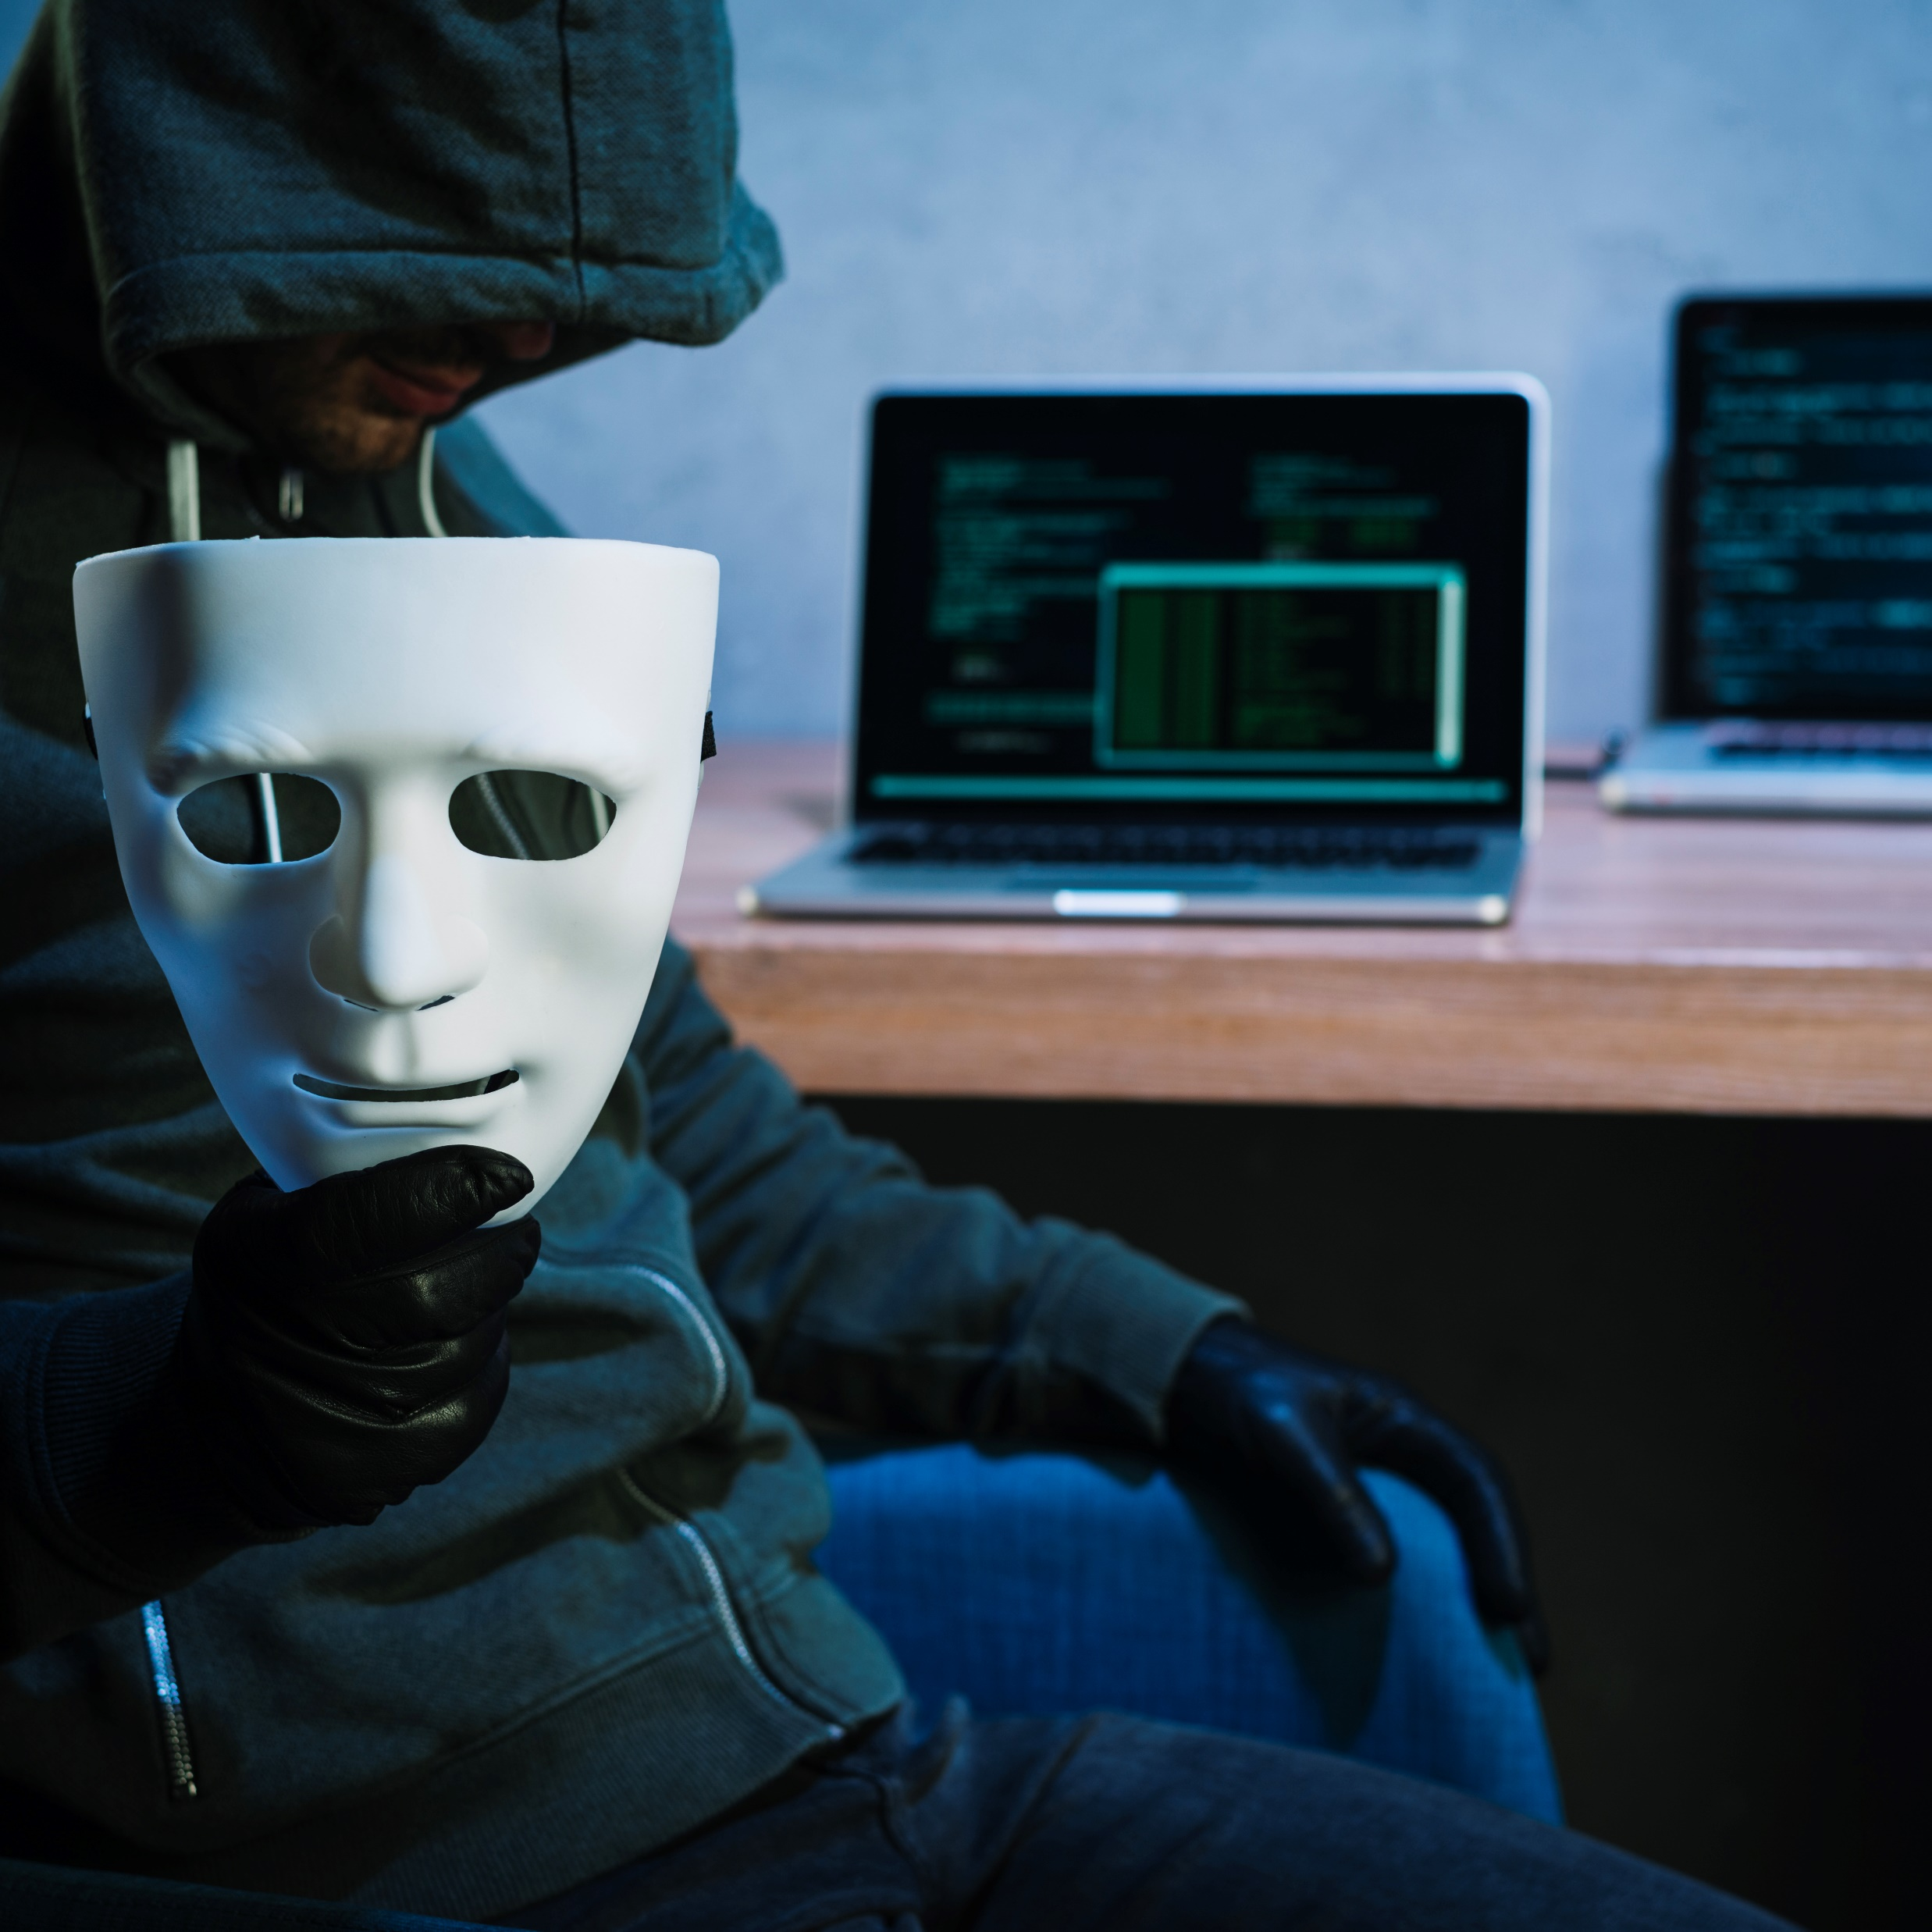
Incident Response – Act Quickly!
Stop interacting with the suspicious website or message.
Change compromised passwords through the official website.
Revoke suspicious active sessions.
Enable or reset multi-factor authentication.
Contact your bank or affected organization if necessary.
Report the incident to the appropriate security team.

Slide 11
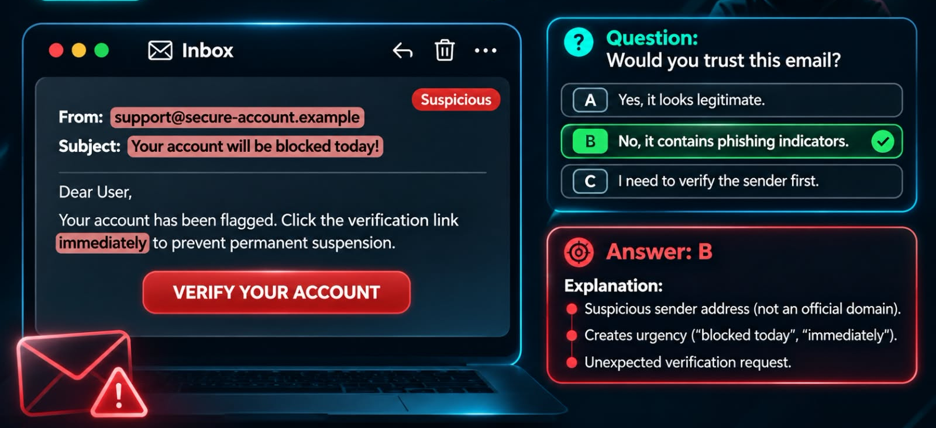
Interactive quiz – Spot the phishing email

Slide 12
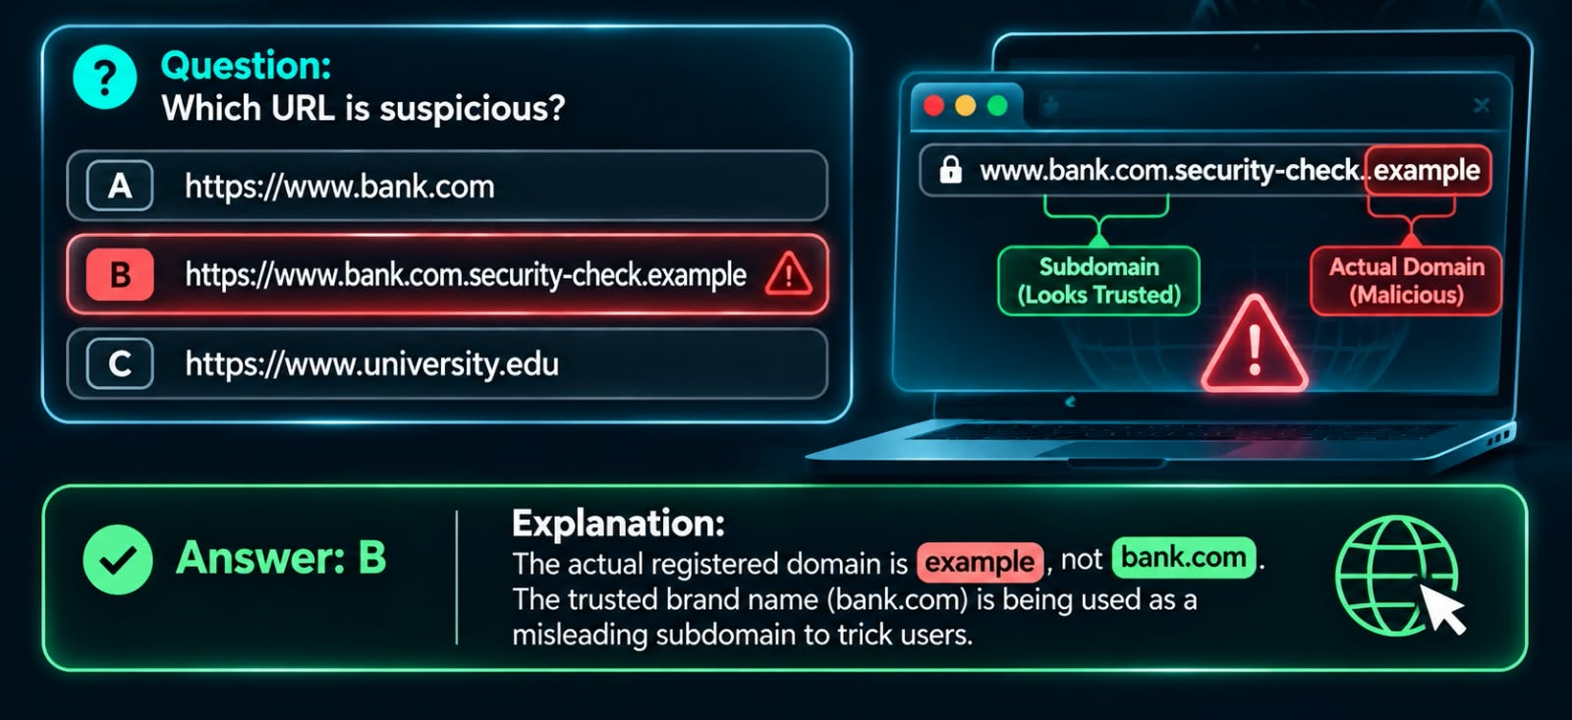
Interactive quiz – Identify the suspicious URL

